Slide 1
Graph Mining HW1 Due: 4/23 (Fri) 23:59
2021.3.18

Slide 2
HW1: Find Power Laws
請找到和分析dataset，驗證power law的存在
Dataset 可為publicly available或是自行取得
得出之Power Law：請多說些我們不知道的
財富分配、小說的social network的degree distribution、文字的出現頻率、電網、neurons有power law我們已經知道了
找到之Power Law的Novelty會是評分的關鍵

Slide 3
評分重點
Observing “Novel” Power Laws
New power laws in existing datasets -> Good
Novelty of Dataset Analyzed
New power laws in “new” datasets -> Even Better!
Evaluation and Validation
Dataset should be large enough
Please make your analysis as rigorous as possible
Additional Findings (bonus)
For example, if you find some factors that may make some widely-accepted power laws no longer hold

Slide 4
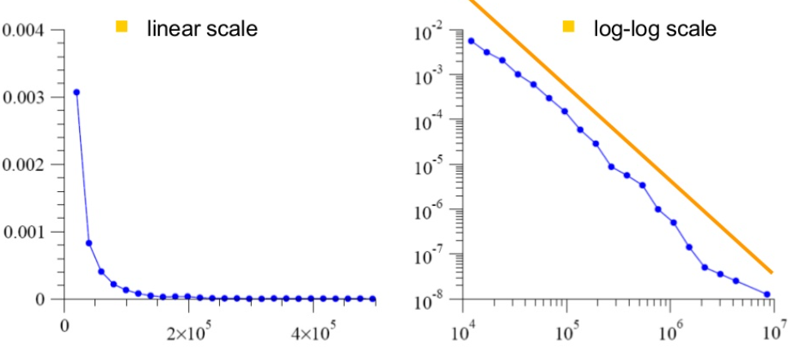
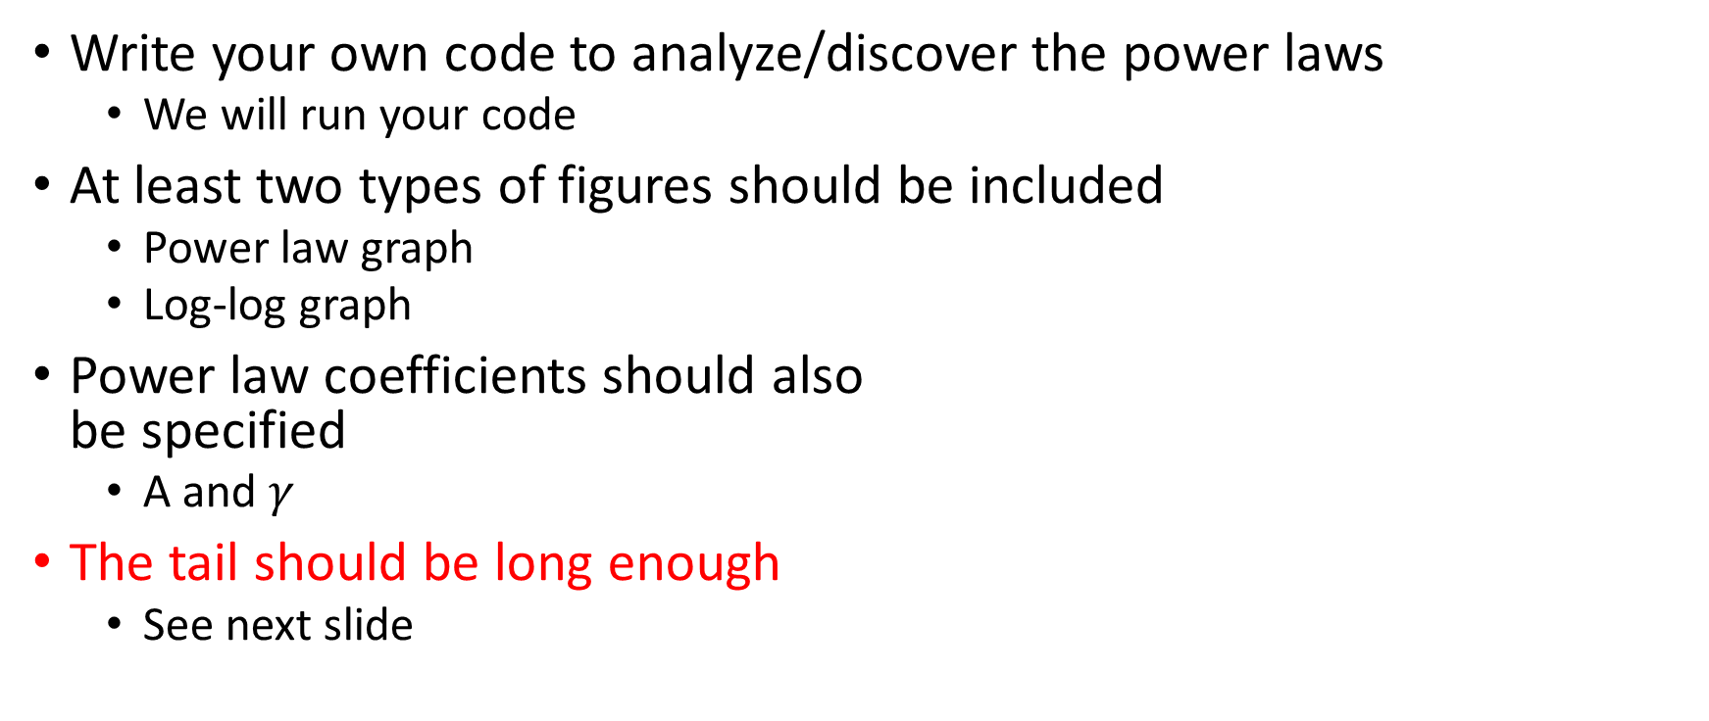
Requirements
Write your own code to analyze/discover the power laws
We will run your code
At least two types of figures should be included
Power law graph
Log-log graph
Power law coefficients should also be specified
A and $γ$
The tail should be long enough
See next slide

Slide 5
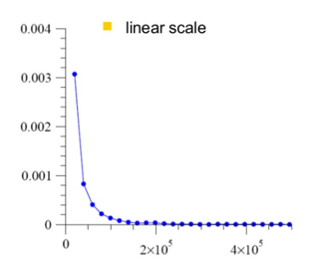
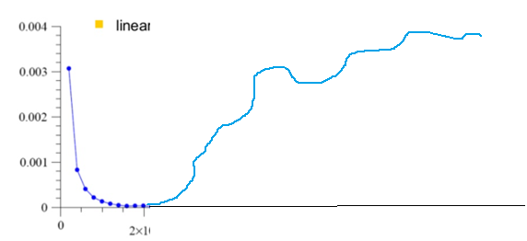
The tail should be long enough

Slide 6
How to hand in your HW1 -1
HW1 is a “group” homework
1-3 members in each group
Files to submit:
A report file
In PDF format
Within 10 pages
中文英文皆可
Codes, datasets, brief ReadMe file
Please upload the datasets and your codes
A brief (but clearly written) readme file should be included
In certain cases, TA will run your code to reproduce the reported results
Summary of contributions of each group member
Each member needs to contribute
A 5-10 min in-class presentation
To report your findings to the class

Slide 7
How to hand in your HW1 -2
4/23 (Fri) 23:59 (firm deadline)
Submit your report, codes, datasets, etc to iLMS
No late submissions
Presentation
To be scheduled 1 or 2 weeks after deadline

Slide 8
Dos and Don’ts
Do:
Do your own analysis with your own code
Clearly cite others’ works if you borrow ideas/datasets from them
Validate your claim with experiments and figures
Don’ts
Rephrase/copy others’ ideas without proper citations
Make claims without proper justification and validations
Treating a special case as general case. If you’d like to report this, please also clearly state how to repeat that “special case”

Slide 9
Grading Criteria
Lecturer and TA – 70%
Novelty
Evaluation and validation of claims
Additional findings
Reproducibility
Presentation
Class – 30%
互評 (presentation)

